Slide 1
Chapter 5: Process Synchronization

Slide 2
Chapter 5: Process Synchronization
Classic Problems of Synchronization
Monitors
Synchronization Examples
Alternative Approaches

Slide 3
Objectives
To examine several classical process-synchronization problems
To explore several tools that are used to solve process synchronization problems

Slide 4
Classical Problems of Synchronization
Classical problems used to test newly-proposed synchronization schemes
  Bounded-Buffer Problem
  Readers and Writers Problem
  Dining-Philosophers Problem

Slide 5
Bounded-Buffer Problem
n buffer cells, each can hold one item
Semaphore mutex initialized to the value 1
Semaphore full initialized to the value 0
Semaphore empty initialized to the value n

Slide 6
Bounded Buffer Problem (Cont.)
The structure of the producer process
do {
// produce an item in nextp
wait (empty);
wait (mutex);
// add the item to the buffer
signal (mutex);
signal (full);
} while (TRUE);
The structure of the consumer process
do {
wait (full);
wait (mutex);
// remove an item from buffer to nextc
signal (mutex);
signal (empty);
// consume the item in nextc
} while (TRUE);

Slide 7
Readers-Writers Problem
A data set is shared among a number of concurrent processes
  Readers – only read the data set; they do not perform any updates
  Writers – can both read and write
Problem:
  Allow multiple readers to read at the same time
  Only one single writer can access the shared data at the same time

Slide 8
Readers-Writers Problem
Several variations of how readers and writers are considered – all involve some form of priorities
  First variation – no reader kept waiting unless writer has permission to use shared object
  Second variation – once writer is ready, it performs write asap
  Both may have starvation leading to even more variations
  Problem is solved on some systems by kernel providing reader-writer locks

Slide 9
Readers-Writers Problem
Shared Data:
  Data set
  Semaphore wrt initialized to 1
  Semaphore mutex initialized to 1
  Integer readcount initialized to 0

Slide 10
Readers-Writers Problem (Cont.)
The structure of a writer process
do {
wait (wrt) ;
// writing is performed
signal (wrt) ;
} while (TRUE);
The structure of a reader process
do {
wait (mutex) ;
readcount ++ ;
if (readcount == 1)
wait (wrt) ;
signal (mutex)
// reading is performed
wait (mutex) ;
readcount - - ;
if (readcount == 0)
signal (wrt) ;
signal (mutex) ;
} while (TRUE);

Slide 11

Dining-Philosophers Problem
Philosophers spend their lives alternating thinking and eating
Don’t interact with their neighbors, occasionally try to pick up 2 chopsticks (one at a time) to eat from bowl
  Need both to eat, then release both when done
In the case of 5 philosophers
  Shared data:
    Bowl of rice (data set)
    Semaphore chopstick [5] initialized to 1

Slide 12
Dining-Philosophers Problem Algorithm
The structure of Philosopher i:
    do {
    wait (chopstick[i] );
    wait (chopStick[ (i + 1) % 5] );
    // eat
    signal (chopstick[i] );
    signal (chopstick[ (i + 1) % 5] );
    // think
    } while (TRUE);
What is the problem with this algorithm?

Slide 13
Dining-Philosophers Problem Algorithm (Cont.)
Deadlock handling
  Allow at most 4 philosophers to be sitting simultaneously at the table.
  Allow a philosopher to pick up the chopstics only if both are available (picking must be done in a critical section.
  Use an asymmetric solution -- an odd-numbered philosopher picks up first the left chopstick and then the right chopstick. Even-numbered philosopher picks up first the right chopstick and then the left chopstick.

Slide 14
Problems with Semaphores
Incorrect use of semaphore operations:
  signal (mutex) …. wait (mutex)
  wait (mutex) … wait (mutex)
  Omitting of wait (mutex) or signal (mutex) (or both)
Deadlock and starvation are possible.

Slide 15
Monitors
A high-level abstraction that provides a convenient and effective mechanism for process synchronization
Abstract data type, internal variables only accessible by code within the procedure
Only one process may be active within the monitor at a time

Slide 16
Monitors
But not powerful enough to model some synchronization schemes
    monitor monitor-name
    {
    // shared variable declarations
    procedure P1 (…) { …. }
    procedure Pn (…) {……}
    Initialization code (…) { … }
    }
    }

Slide 17

Schematic view of a Monitor
Monitor M1
Procedure 1(v1,v2,…)
begin…………………..end
Procedure 2(v1,v2,…)
begin…………………..end
.
.
.
Shared variables
v1,v2,…,vn
P2
P4
P1
Executing procedure 2 in M1

Slide 18
Condition Variables
condition x, y;
Two operations are allowed on a condition variable:
  x.wait() – a process that invokes the operation is suspended until x.signal()
  x.signal() – resumes one of processes (if any) that invoked x.wait()
    If no x.wait() on the variable, then it has no effect on the variable

Slide 19

Monitor with Condition Variables

Slide 20
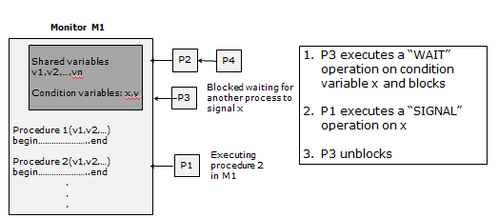
Monitor with Condition Variables
If a SIGNAL operation is performed and no process is waiting on the condition, then the SIGNAL operation has no effect

Slide 21
Monitors: Reader-Writer Problem
Monitor R-W
Procedure Startread
if(busy OR OKtowrite.queue) OKtoread.wait
readers= readers+1
OKtoread.signal
Procedure Finishread
readers= readers-1
if(readers==0) OKtowrite.signal
Procedure Startwrite
if(busy OR readers!=0) OKtowrite.wait
busy= TRUE
Procedure Finishwrite
busy=FALSE
if(OKtowrite.queue) OKtowrite.signal
else Oktoread.signal
Shared variables
busy: boolean FALSE
readers: int 0
Condition variables:
OKtoread, OKtowrite
writer
Blocked waiting for R-W
reader
Executing Startread

Slide 22
Monitors: Reader-Writers Problem
Only one process executing any of the procedures inside the monitor
Typical sequence:
  Readers request to enter monitor
  Reader enters monitor to execute Startread procedure
  It generates OKtoread signal inside procedure
  Leaves monitor
  Starts the actual reading
  Finishes reading
  Requests entering monitor
  Reader enters monitor to execute Finishread procedure
If a writer is waiting on Oktowrite, no new reader can start reading

Slide 23
Condition Variables Choices
If process P invokes x.signal(), and process Q is suspended in x.wait(), what should happen next?
  Both Q and P cannot execute in paralel. If Q is resumed, then P must wait
Options include
  Signal and wait – P waits until Q either leaves the monitor or it waits for another condition
  Signal and continue – Q waits until P either leaves the monitor or it waits for another condition

Slide 24
Condition Variables Choices
Both have pros and cons – language implementer can decide
Monitors implemented in Concurrent Pascal compromise
  P executing signal immediately leaves the monitor, Q is resumed
Implemented in other languages including Mesa, C#, Java

Slide 25
Monitor Solution to Dining Philosophers
monitor DiningPhilosophers
{
enum { THINKING; HUNGRY, EATING} state [5] ;
condition self [5];
void pickup (int i) {
state[i] = HUNGRY;
test(i);
if (state[i] != EATING) self [i].wait;
}
void putdown (int i) {
state[i] = THINKING;
// test left and right neighbors
test((i + 4) % 5);
test((i + 1) % 5);
}
void test (int i) {
if ( (state[(i + 4) % 5] != EATING) &&
(state[i] == HUNGRY) &&
(state[(i + 1) % 5] != EATING) ) {
state[i] = EATING ;
self[i].signal () ;
}
}
initialization_code() {
for (int i = 0; i < 5; i++)
state[i] = THINKING;
}
}

Slide 26
Monitor Solution to Dining Philosophers
Each philosopher i invokes the operations pickup() and putdown() in the following sequence:
DiningPhilosophers.pickup (i);
EAT
DiningPhilosophers.putdown (i);
No deadlock, but starvation is possible

Slide 27
Monitor Implementation Using Semaphores
Variables
semaphore mutex; // (initially = 1)
semaphore next; // (initially = 0)
int next_count = 0;
Each procedure F will be replaced by
wait(mutex);
…
body of F;
…
if (next_count > 0)
signal(next)
else
signal(mutex);
Mutual exclusion within a monitor is ensured

Slide 28
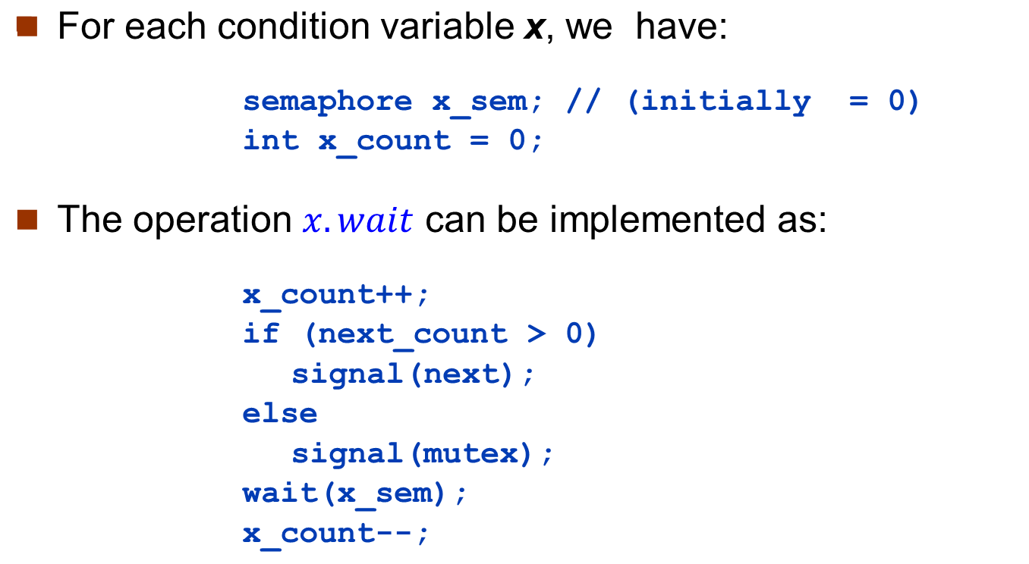
Monitor Implementation – Condition Variables

Slide 29
Monitor Implementation (Cont.)
The operation x.signal can be implemented as:
if (x_count > 0) {
next_count++;
signal(x_sem);
wait(next);
next_count--;
}

Slide 30
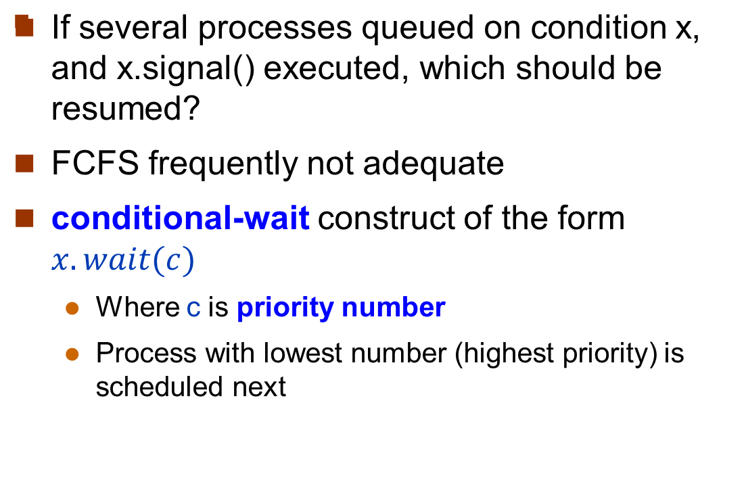
Resuming Processes within a Monitor

Slide 31
Single Resource allocation
Allocate a single resource among competing processes using priority numbers that specify the maximum time a process plans to use the resource
R.acquire(t);
...
access the resource;
...
R.release;
Where R is an instance of type ResourceAllocator

Slide 32
A Monitor to Allocate Single Resource
monitor ResourceAllocator
{
boolean busy;
condition x;
void acquire(int time) {
if (busy)
x.wait(time);
busy = TRUE;
}
void release() {
busy = FALSE;
x.signal();
}
initialization code() {
busy = FALSE;
}
}

Slide 33
Problems with the monitor
A process might access a resource without firs gaining access permission to the resource
A process might never release once it has been granted access to resource
A process might request access the same resource twice

Slide 34
Synchronization Examples
Solaris
Windows
Linux
Pthreads

Slide 35
Solaris Synchronization
Implements a variety of locks to support multitasking, multithreading (including real-time threads), and multiprocessing
Uses adaptive mutexes for efficiency when protecting data from short code segments
  Starts as a standard semaphore spin-lock
  If lock held, a thread running on another CPU, spins
  If lock held by non-run-state thread, block and sleep waiting for signal of lock being released
Uses condition variables
Uses readers-writers locks when longer sections of code need access to data
Uses turnstiles to order the list of threads waiting to acquire either an adaptive mutex or reader-writer lock
  Turnstiles are queue structures containing threads blocked on a lock

Slide 36
Windows Synchronization
Uses interrupt masks to protect access to global resources on uniprocessor systems
Uses spinlocks on multiprocessor systems
  Spinlocking-thread will never be preempted
For thread synchronization outside the kernel provides dispatcher objects – threads synchronize using according to different mechanisms, including mutexes, semaphores, events, and timers
  Events
    An event acts much like a condition variable
  Timers notify one or more threads when time expired
  Dispatcher objects either signaled-state (object available) or non-signaled state (thread will block)

Slide 37
Linux Synchronization
Linux:
  Prior to kernel Version 2.6, disables interrupts to implement short critical sections
  Version 2.6 and later, fully preemptive
Linux provides:
  Semaphores
  atomic integers
  spinlocks
  reader-writer versions of these two locks
On single-CPU system, spinlocks replaced by enabling and disabling kernel preemption
Single Processor | Multiple processors
Disable kernel preemption | Acquire spin lock
Enable kernel preemption | Release spin lock

Slide 38
Pthreads Synchronization
Pthreads API is OS-independent
It provides:
  mutex locks
  condition variable
Non-portable extensions include:
  read-write locks
  spinlocks

Slide 39
Alternative Approaches
Transactional Memory
OpenMP
Functional Programming Languages

Slide 40
Transactional Memory
A memory transaction is a sequence of read-write operations to memory that are performed atomically.
void update()
{
/* read/write memory */
}

Slide 41
OpenMP
OpenMP is a set of compiler directives and API that support parallel programming.
void update(int value)
{
#pragma omp critical
{
count += value
}
}
The code contained within the #pragma omp critical directive is treated as a critical section and performed atomically.

Slide 42
Functional Programming Languages
Functional programming languages offer a different paradigm than procedural languages in that they do not maintain state.
Variables are treated as immutable and cannot change state once they have been assigned a value.
There is increasing interest in functional languages such as Erlang and Scala for their approach in handling data races.

Slide 43
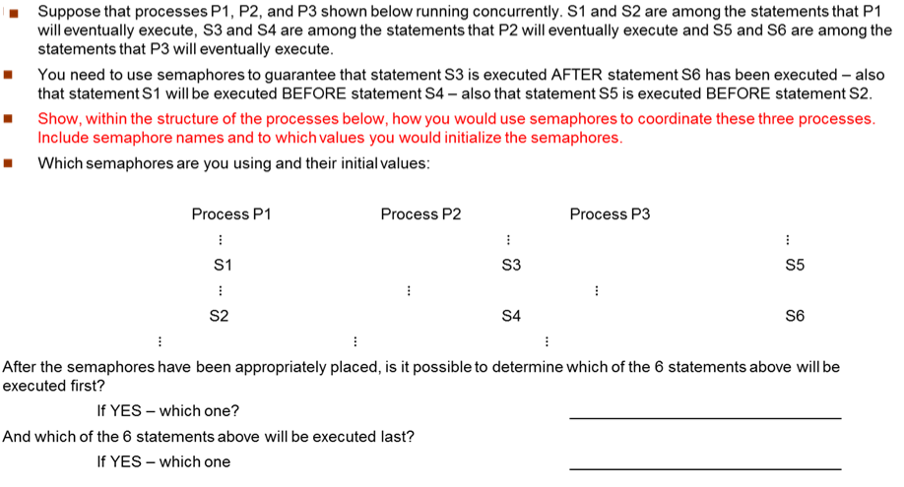
Synchronization using semaphores

Slide 44
The Bounded-Buffer Problem
Q2. A producer and a consumer threads are sharing a buffer as shown below. The buffer is initialized with “blank” characters in each position. Semaphores X, Y, and Z are used to protect the buffer and are initializing properly. After the threads have been running for a while, the buffer appears as shown below and the threads are executing at the location shown by the arrows below. If the last character placed in the buffer was ‘8’ and the value of semaphore Y is 5, answer the question below.
What was the value of semaphore X when it was initialized? ________________
What is the value of semaphore X now? _________________
What is the value of the consumer buffer index now? _________________
What is the value of the producer buffer index now? _________________
Which was the last character read by the consumer? _________________
Which specific character that are still in the buffer HAVE BEEN READ by the consumer ________________________
Consumer
Repeat
do other calculation
P(X)
P(Z)
Read item from buffer
V(Z)
Do other calculation
V(Y)
Until false
Producer
Repeat
do other calculation
P(Y)
P(Z)
Place item in buffer
V(Z)
Do other calculation
V(X)
Until false

Slide 45
End of Chapter 5

